Slide 1
Lecture – 2 Constants, Variables and Data Types

Slide 2
Constants
Constants in c refer to fixed values that do not change during the execution of a program.
For example : 123 0.0083 ‘f’
C supports several types of constants as illustrated.
Constants
Numeric Constants
Character Constants
Integer Constants
Real Constants
Single Character Constants
String Constants

Slide 3
Variables
A variable is a named memory location that can hold various values.
Var
All Variables must be declared before they can be used.
A variable may take different values at different times during execution.
10
1.50
b
3.789456

Slide 4
Data types
C supports five basic data types.
Type | Keyword | Examples
Character data | char | ‘A’,’a’,’m’,’z’
Signed whole number | int | 10,4,-9,1234567
Floating point number | float | 1.50, 89.098, -9.8
Double precision Floating point number | double | 1.0000000067
valueless | void

Slide 5
Declaration of variables
Declaration does two things :
It tells the compiler what the variable name is.
It specifies what type of data the variable will hold.
To declare a variable use this general form:
type var-name;
where type is a C data type and var-name is the name of the variable.
For example : int counter;
this declares counter to be of type int.
To declare more than one variable of same type use comma separated list . For example : float x, y, z ;

Slide 6
Conditions for variable naming:
Variable names may consist of letters , digits and the underscore character that must follow following conditions:
They must begin with a letter .Some System permit underscore as the first character.
ANSI standard recognizes a length of 31 characters. However length should not be normally more than eight character.
Uppercase and lowercase are significant .That is variable Total and total are different.
It should not be a keyword.
White space is not allowed.

Slide 7
Examples of variable names:
Variable name | Valid or not valid | Remark
First_tag | valid
char | Not valid | char is a keyword
price$ | Not valid | Dollar sign is illegal
group one | Not valid | Blank space is not permitted.
average_number | valid | First eight characters are significant
Int_type | valid | Keyword may be part of a name

Slide 8
Assigning values to variable:
Values can be assigned to variables using the assignment operator = as follows:
variable_name = constant;
for example: a=10;
b=20;
c=‘A’;
It is also possible to assign a value to a variable at the time variable is declared. This takes the following form:
data-type variable_name = constant;
for example: int x=10;
int y=20;
char ch=‘A’;
The process of giving initial values to variables is called initialization.

Slide 9
Format specifier
Data Type | Format Specifier
Integer | %d
Float | %f
Double | %f
Character | %c
String | %s

Slide 10
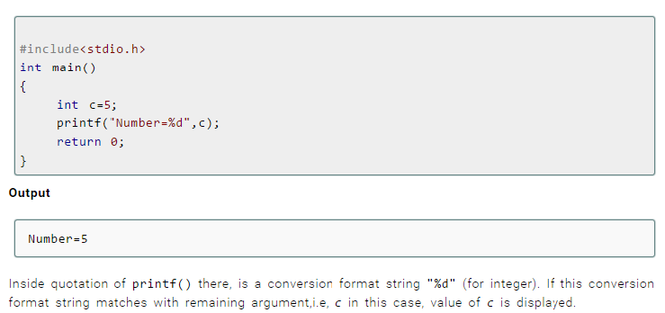
I/O of integers in C

Slide 11
Input Number from the User
One of the easiest way to input numeric values from the keyboard is use of another C’ s standard library function called scanf().
To read an integer value from the keyboard, call scanf() using general form
scanf(“%d”,&int_var_name);
For example:
int num;
scanf(“%d”,&num);

Slide 12
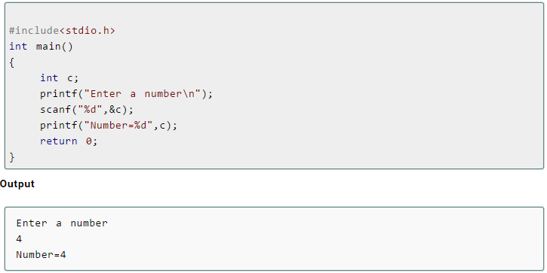
Let us consider another Program:

Slide 13
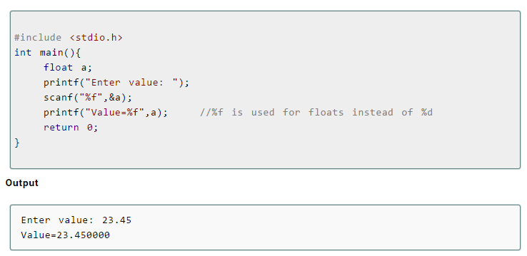
To read a float value from the keyboard, call scanf() using general form
scanf(“%f”,&float_var_name);
For example:
float num;
scanf(“%f”,&num);

Slide 14
To read a double value from the keyboard, call scanf() using general form
scanf(“%lf”,&double_var_name);
For example:
double d;
scanf(“%lf”,&d);
To read a character value from the keyboard, call scanf() using general form
scanf(“%c”,&char_var_name);
For example:
char ch;
scanf(“%c”,&ch);

Slide 15
Example:
This program asks you to input a character and a double number.
It then displays the values you enter.
#include<stdio.h>
int main(){
char ch;
double d;
printf(“Enter a character”);
scanf(“%c”,&ch);
printf(“Enter a Double precision number”);
scanf(“%lf”,&d);
return 0;
}

